Slide 1
The Next Big Thing
data visualization and design

Slide 2
Who’s this guy?

Slide 3
Guest Speaker! No Critiques!
Alec Singleton
Graduated from YSDN in 2004
Went to work at a boutique design shop in the
west end right away
Ended up designing interactive data visualizations in
the east end

Slide 4
Did some cool stuff

Slide 5
Had some commercial successes

Slide 6
Started to think with the data

Slide 7
Triathlon Magazine Canada

Slide 8
Oculus needed a designer

Slide 9
Oculus

Slide 10
Oculus
Designs and develops interactive visualization solutions for massive datasets
Approx 70 employees
Approx 5 designers
Most offerings licensed as services, rather than discrete products

Slide 11
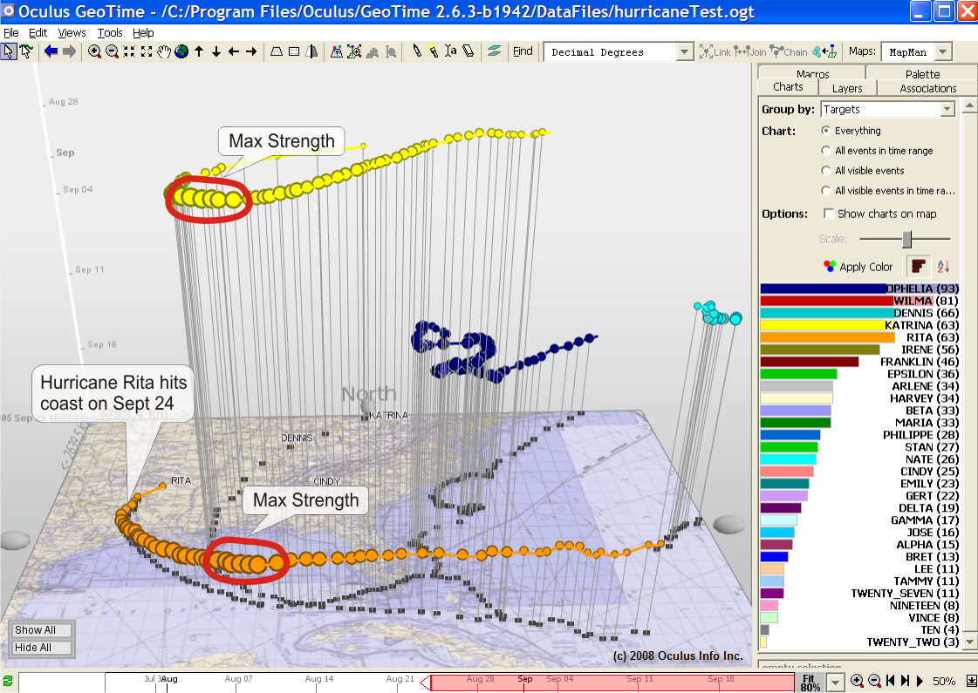
Most of the functionality was already present
Tool layout
Timeline

Slide 12
UI Design was not helping users operate the program
Some UI elements were actually interfering with the display of important data

Slide 13
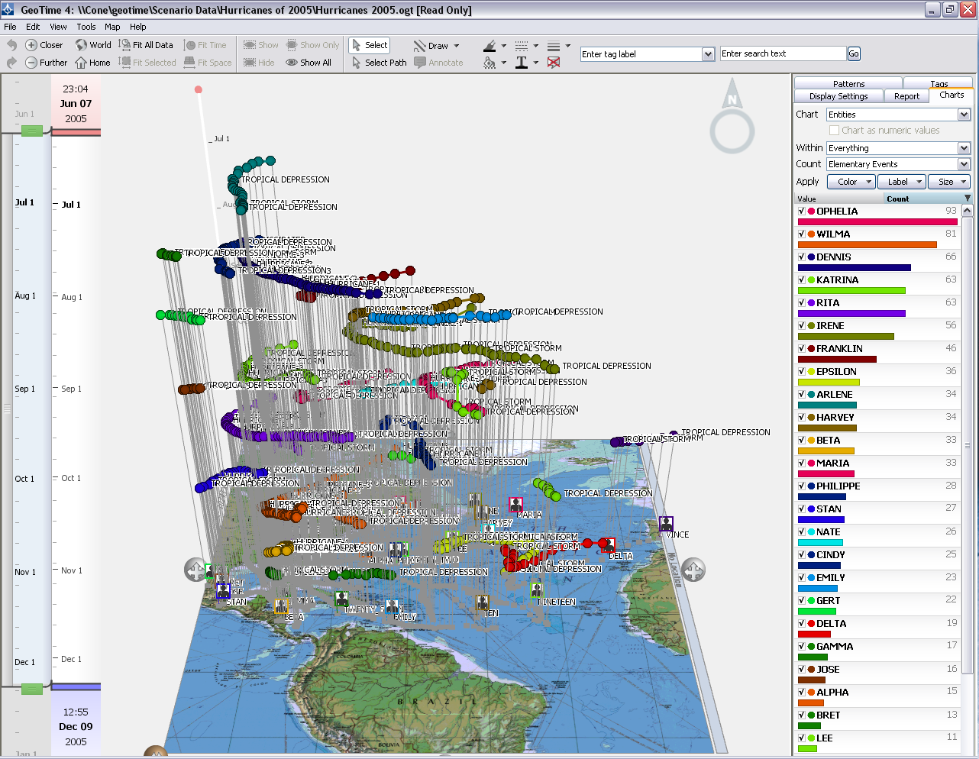
These were problems I could help solve

Slide 14
Worked on improving the overall aesthetic

Slide 15
Me at Oculus
Visualization Designer
Work with developers and clients on commercial projects and government research data visualization projects
Responsibilities include design research, solution conceptualization, proposal development, visualization design, interaction design, developer management

Slide 16
Me at Oculus
Visualization Designer
Work with developers and clients on commercial projects and government research data visualization projects
Responsibilities include design research, solution conceptualization, proposal development, visualization design, interaction design, developer management
Icons. Lots and lots of icons.

Slide 17
Data Visualization

Slide 18
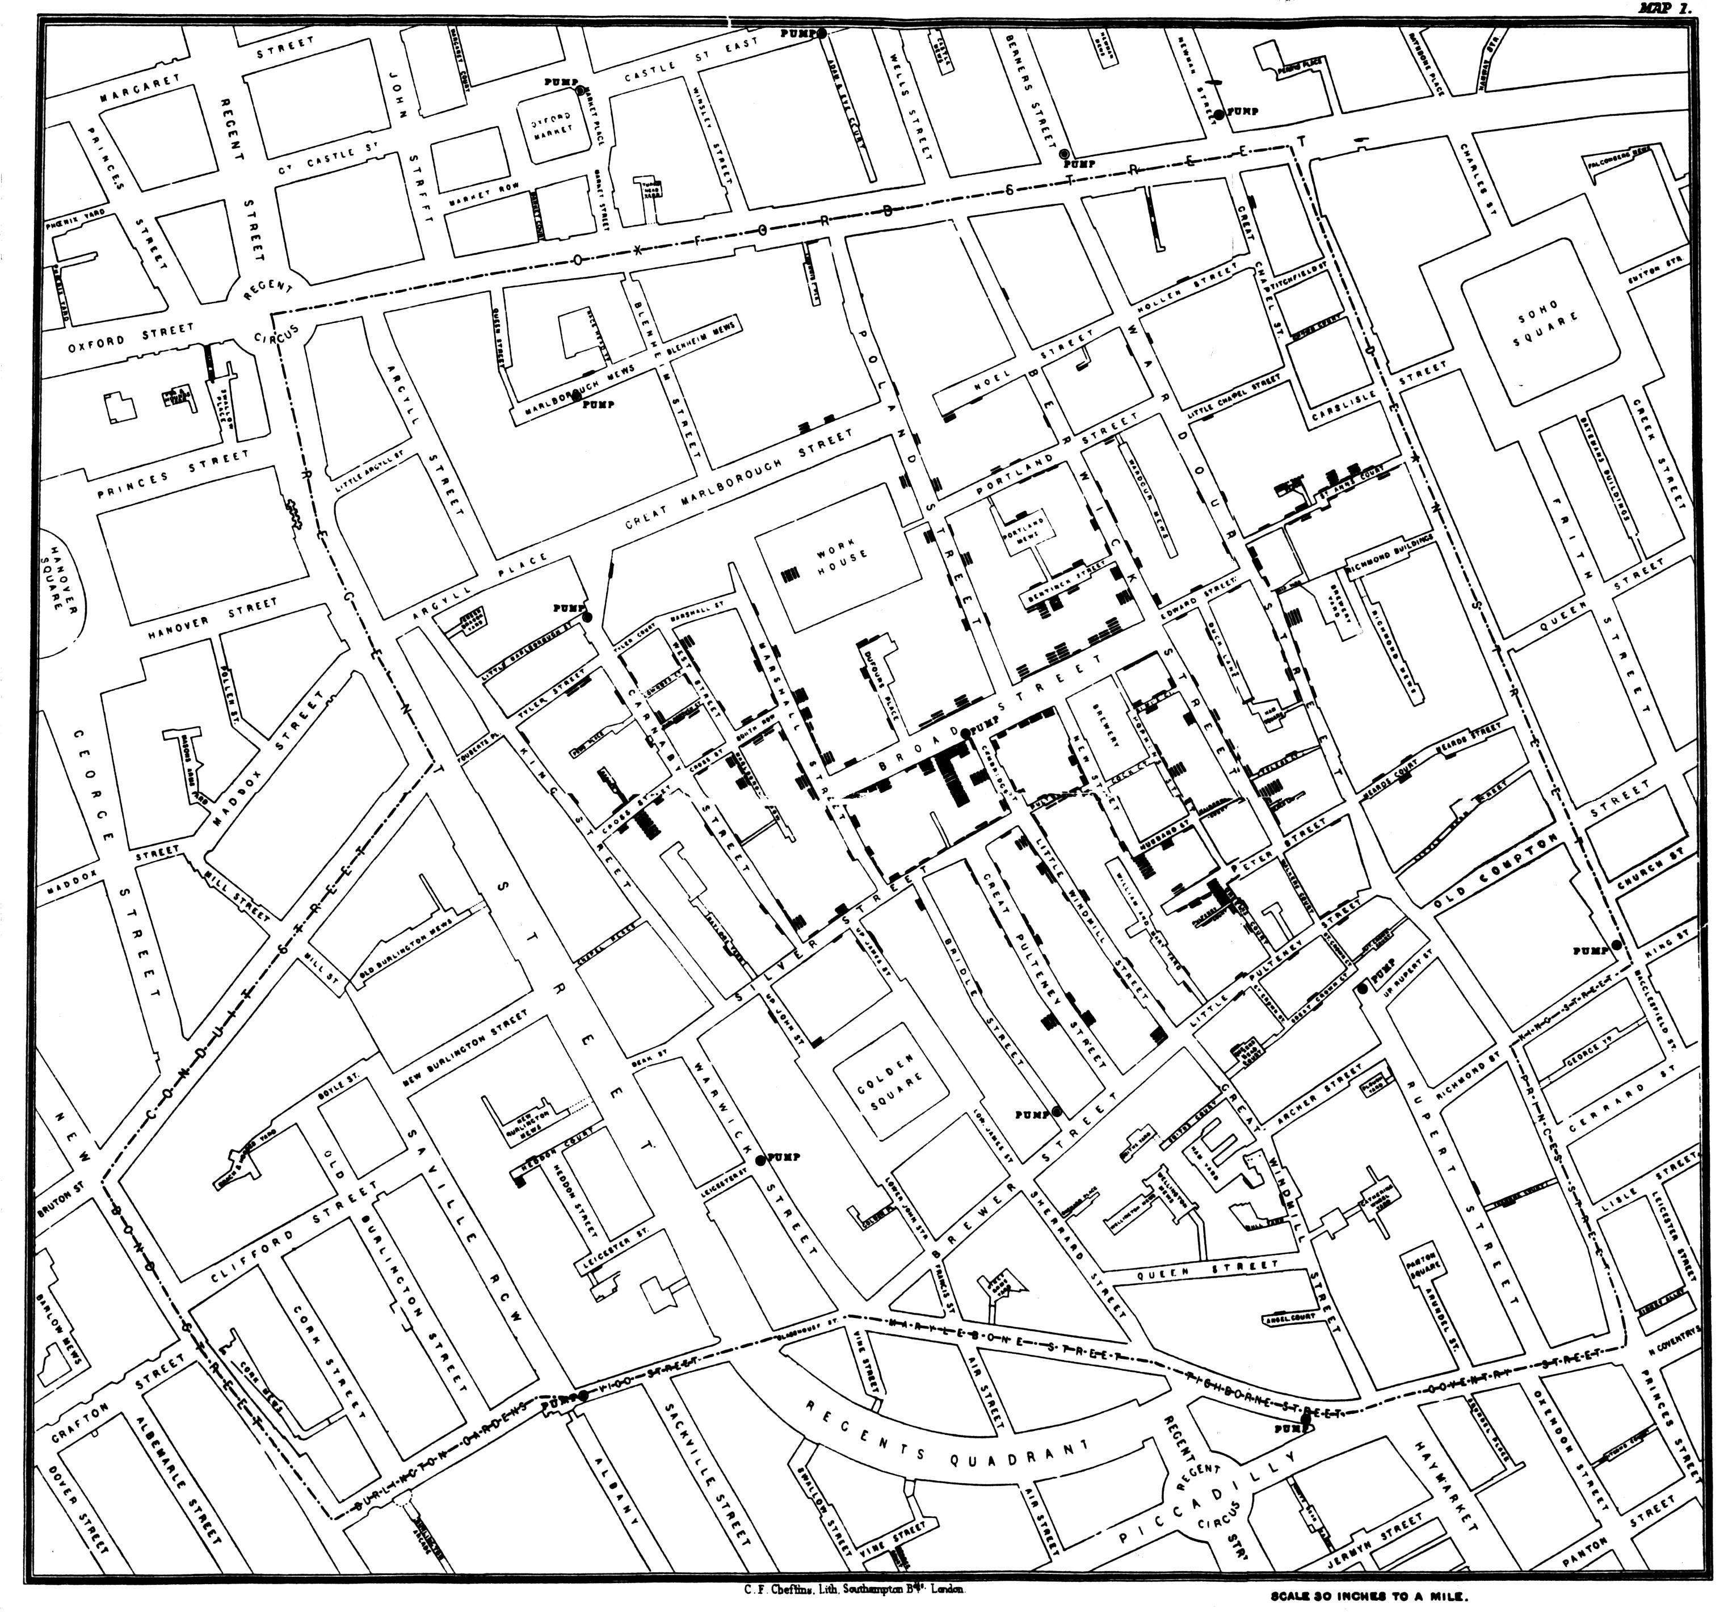
Dr John Snow’s Cholera Map
• Created in 1854
• made the link between drinking water sanitation and Cholera “crystal clear”

Slide 24
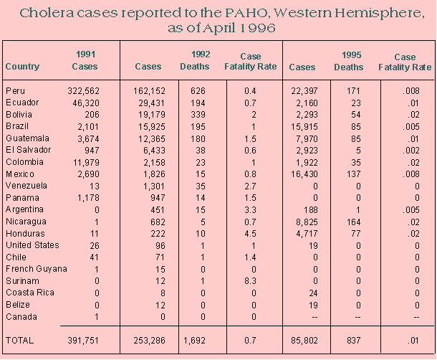

Slide 25
Dr John Snow’s Cholera Map
• Created in 1854
• made the link between drinking water sanitation and Cholera “crystal clear”
• Dr Snow’s visualization persuaded the local council to disable the Broad Street pump
• The outbreak ended
• The pattern presented here resulted in broad sanitation changes, the end of Cholera in the developed world, and new acceptance of germ theory over miasma theory

Slide 26
Florence Nightingale
Credited with Invented modern nursing
Served as a nurse in the Crimean War
Horrified at the conditions in the military hospitals
Compiled reports starkly depicting the damage sanitation was doing to already injured soldiers
Changed hospital sanitation permanently

Slide 27
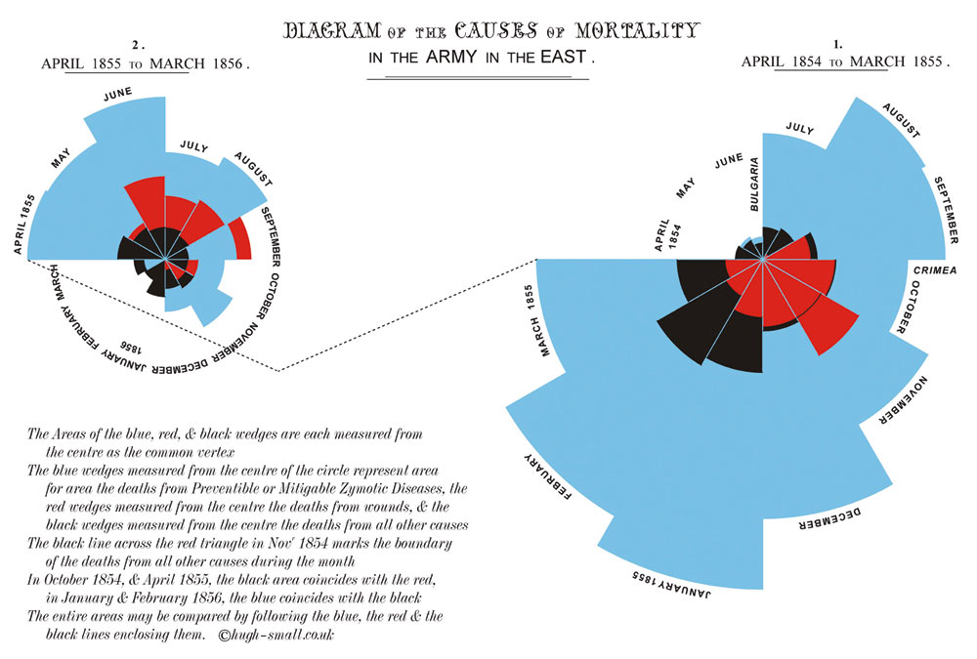

Slide 28
Disease
Wounds suffered in battle
All other causes

Slide 29
Florence Nightingale’s coxcomb plots
• resulted from her extensive statistical analysis of British military casualty reports during the Crimean War
• communicated her statistical analyses to non-mathematician policy makers (including Queen Victoria herself)
• made the need for sanitation in military hospitals clear
• After 10 years of reform, peacetime mortality among Indian soldiers had dropped from 69/1000 to 18/1000
• contributed directly to sanitation practices used in every hospital today

Slide 30
Data visualization has already changed the world

Slide 31
What’s possible now
The internet has made both the distribution and consumption of data very easy
Basic principles of interactivity enable the user to be an active participant in the analysis and presentation of data
This has led to a resurgence of data visualization by journalists to communicate powerful points quickly effectively

Slide 32
Interaction and Data Visualization: Then
Snow and Nightingale: Total Designer Control
Raw data
Selection
Encoding
Presentation
User
Designer

Slide 33
Interaction and Data Visualization: NOW
Interaction allows the user to affect selection, encoding and presentation of data, gives them a central role in data visualization.
User
Raw data
Selection
Encoding
Presentation
Designer

Slide 34
http://www.nytimes.com/interactive/2009/11/06/business/economy/unemployment-lines.html

Slide 37
NYTimes – The Jobless Rate for People Like You
• Created in 2009
• shows the numbers that make up the gross unemployment rate
• shows the factors that demographers and policy makers look at for unemployment
• highlights some pretty big inequities
• implies factors beyond simple demographics affect the unemployment rate

Slide 38
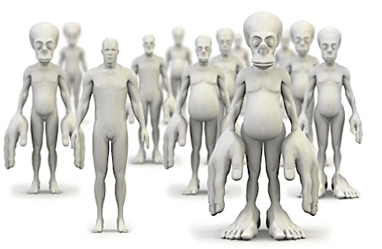
http://www.changinghabbits.co.uk/

Slide 39
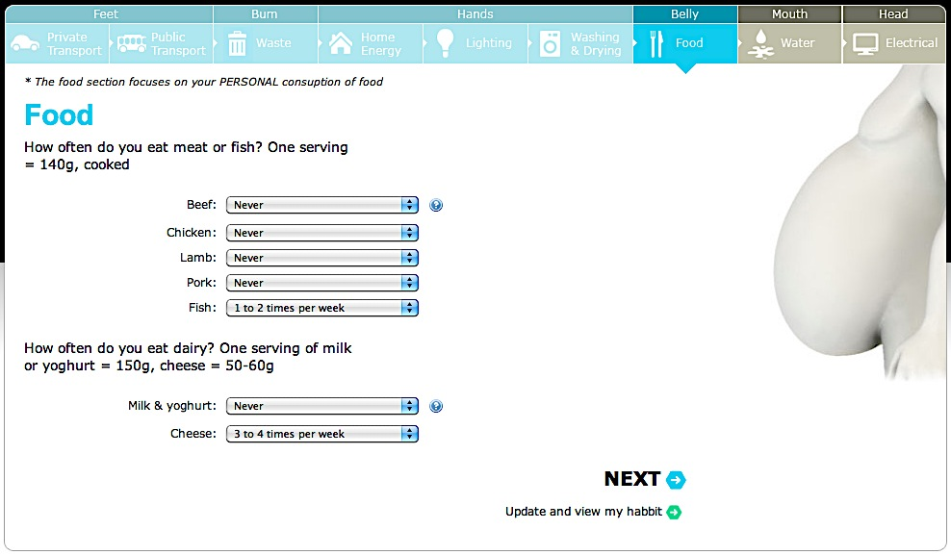
http://www.changinghabbits.co.uk/

Slide 40
http://www.changinghabbits.co.uk/

Slide 41
Changing Habbits
• Created in 2010
• uses data collected from the user to illustrate problems with resource consumption in modern society
• uses qualitative data in a very visceral way to make a strong point

Slide 42
Why it matters
Honest, clear communication requires thoughtful presentation of large amounts of data
Disregarding that care can result in miscommunication, misunderstanding, and potentially catastrophe.
During the Columbia disaster, the point of this slide was to indicate that previous testing didn’t apply to the situation NASA was dealing with. Instead it just focused on the positive results of the testing itself.

Slide 43
Title makes it sound like there’s no problem
The bulk of the slide describes a test that provided positive results
Points on the 4th level of hierarchy contradict this
Another 4th level bullet finally tells the reader that debris in reality is 1920/3, or 640 times larger than that used in tests.

Slide 44
What does the industry look like?

Slide 45
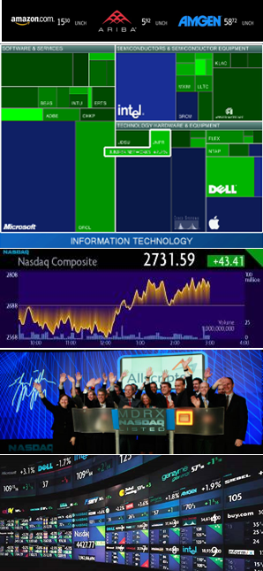
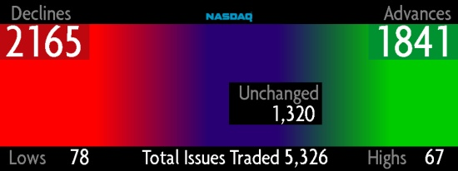
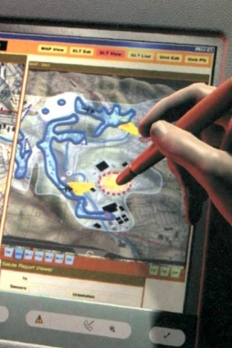
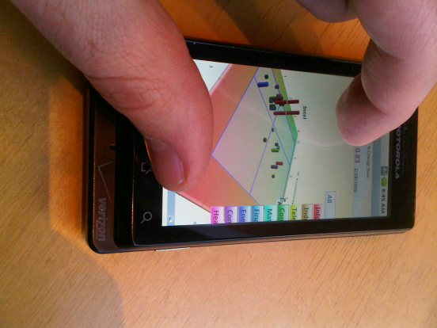
Oculus
Founded 2001
Designs and develops visualization solutions for massive datasets
Clients include government, healthcare, financial industries

Slide 46
GeoTime by Oculus
Oculus’ first retail offering
Combines spatial and temporal data to reveal patterns of movement over time
Customers include telecom, law enforcement, humanitarian, and environmental agencies

Slide 47
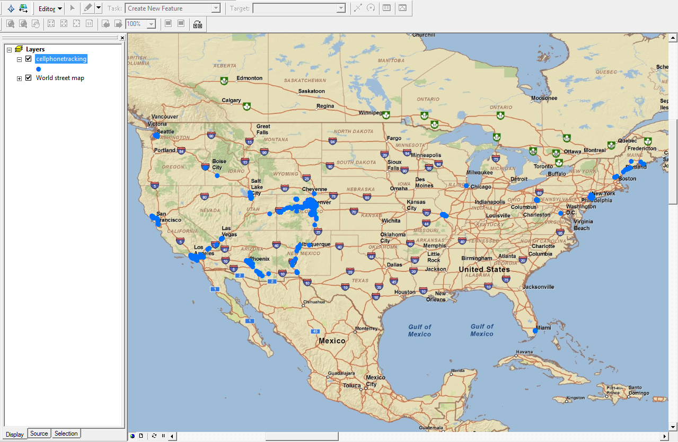
Specialized mapping software: spatial and temporal data

Slide 48
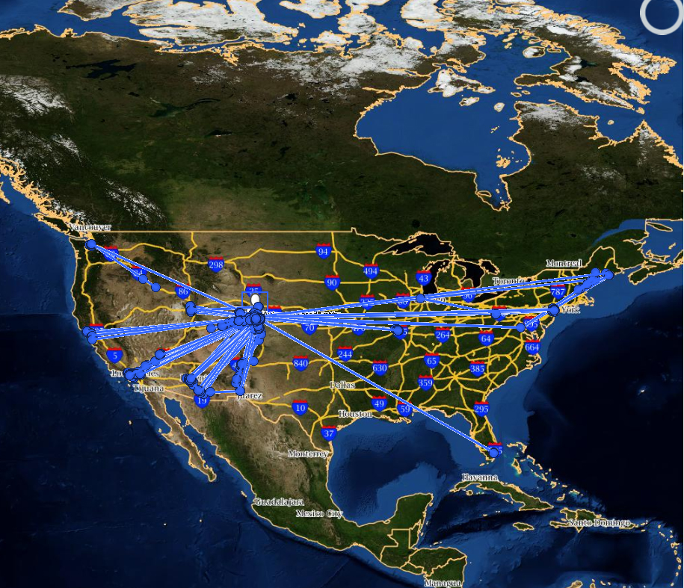
Google Earth: movement data connects specific points

Slide 49
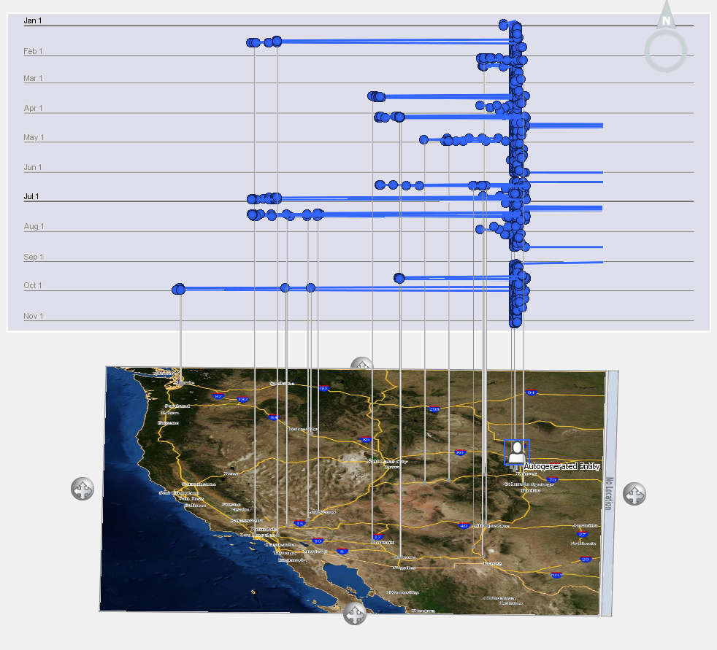
GeoTime: synthesizes spatial, temporal and movement data into one view that enables the user to see movement over time, repeated movements, and anomalies

Slide 50
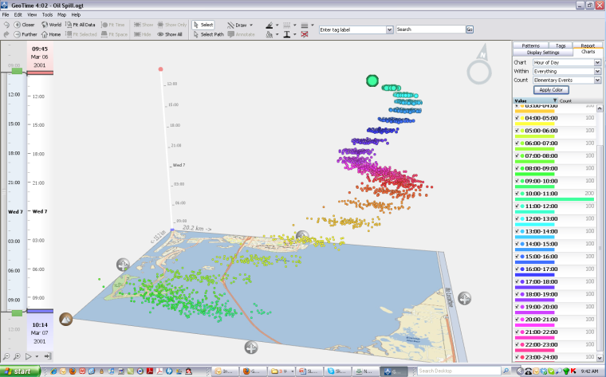
Gradual spread of last summer’s Gulf oil spill

Slide 51
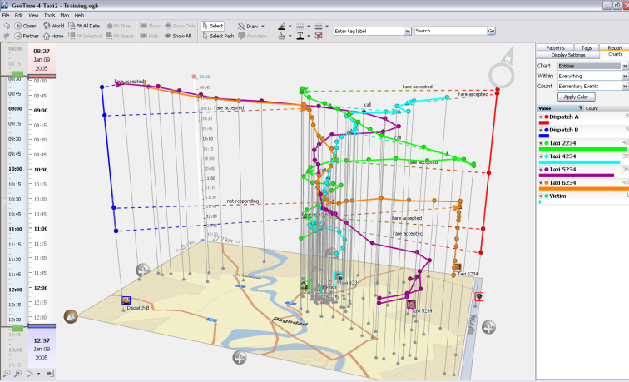
Multiple types of data: taxi cabs movement over time and cell phone calls between the drivers

Slide 52
Stamen
Founded 2001
Stamen creates compelling interactive design and data visualization projects
Clients include:
  MTV
  Adobe
  Nike
  MSNBC

Slide 53
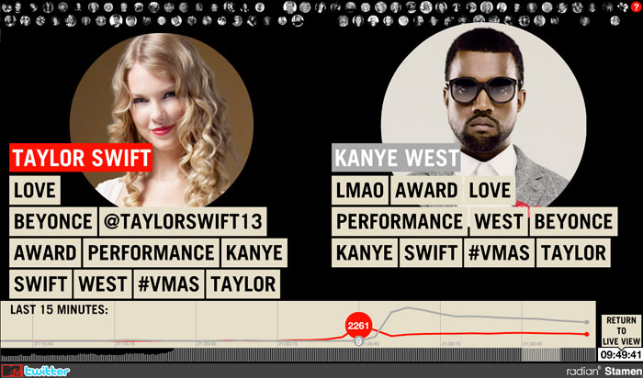
What happened on Twitter following Kanye West’s ad lib.

Slide 54
Stamen believes civic data should be free
have released their spatial visualization model to the public for any civic use

Slide 55
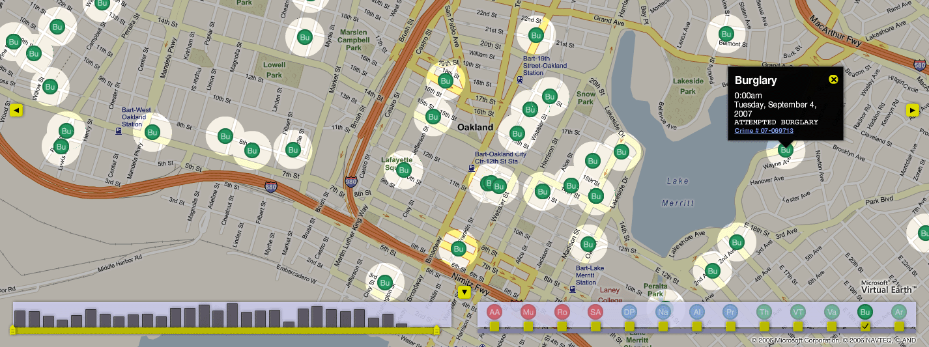
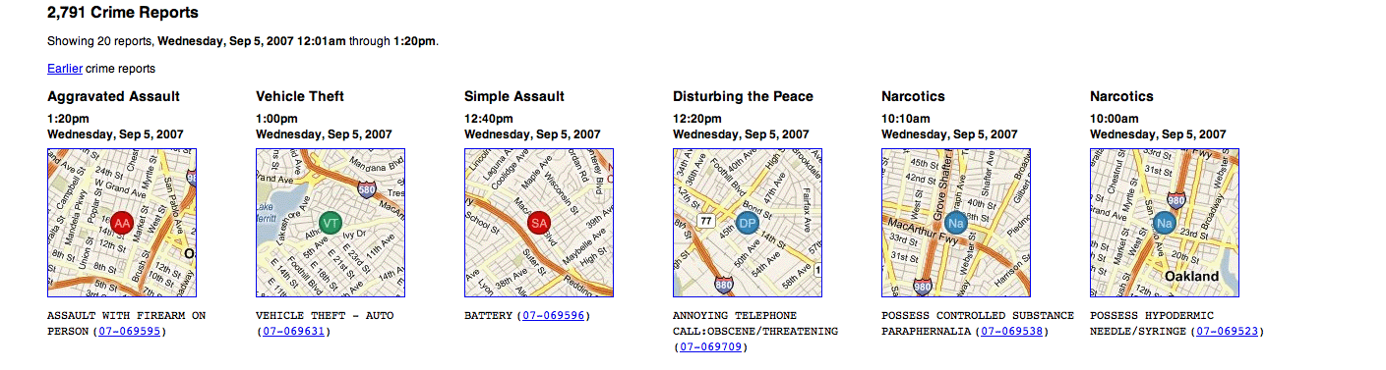
Focus on specific incident types and drill down to details of specific incidents
Location based reporting

Slide 56
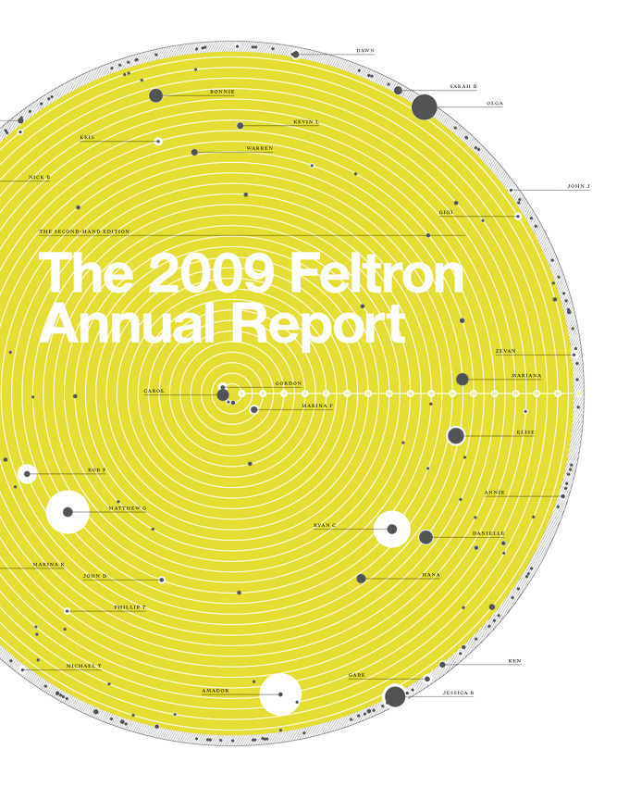
Feltron
Design studio of Nicholas Felton
Focus on static infographics for magazines
Home of Feltron, the Nicholas Felton Annual Report

Slide 57
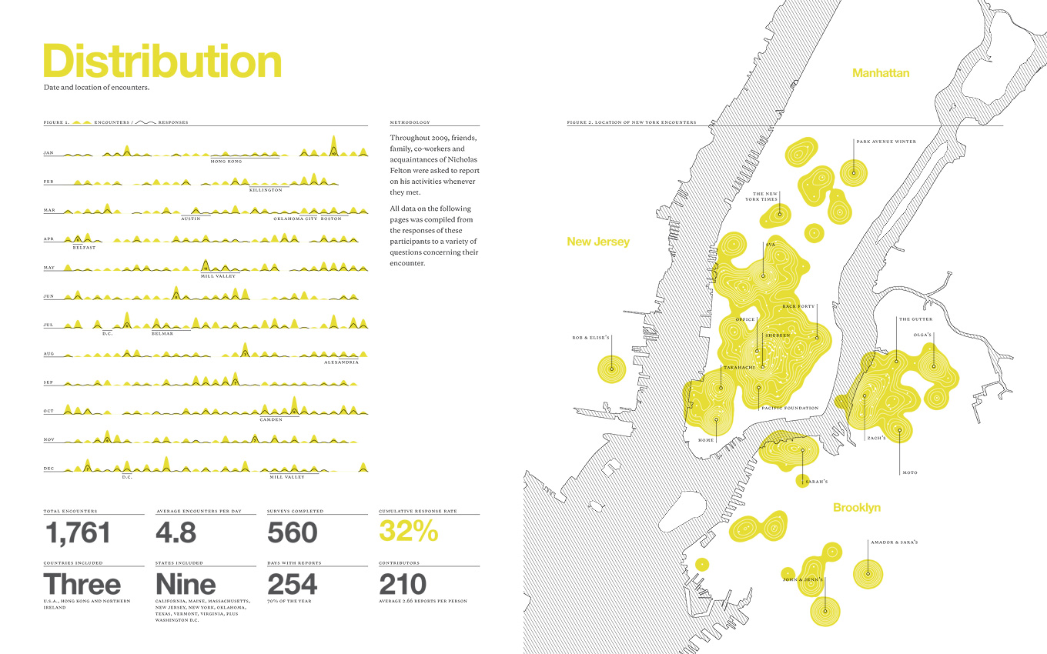

Slide 58
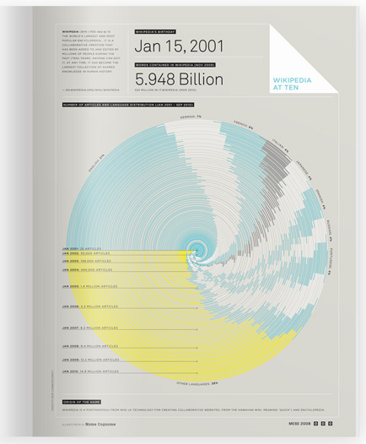

Slide 59
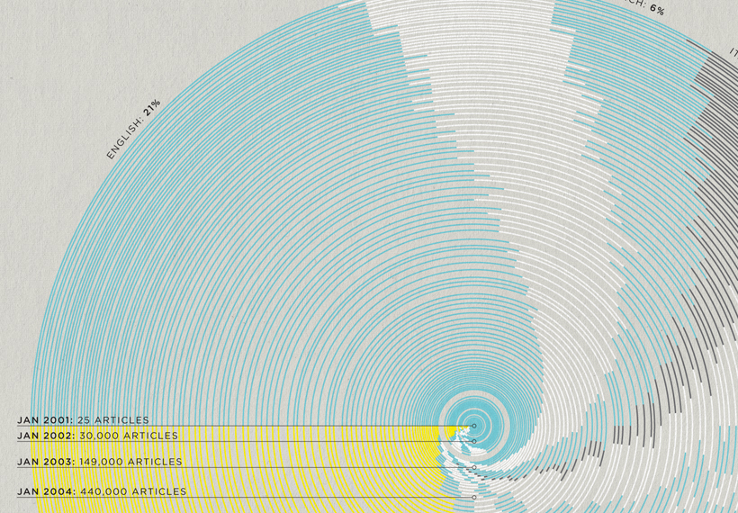

Slide 60
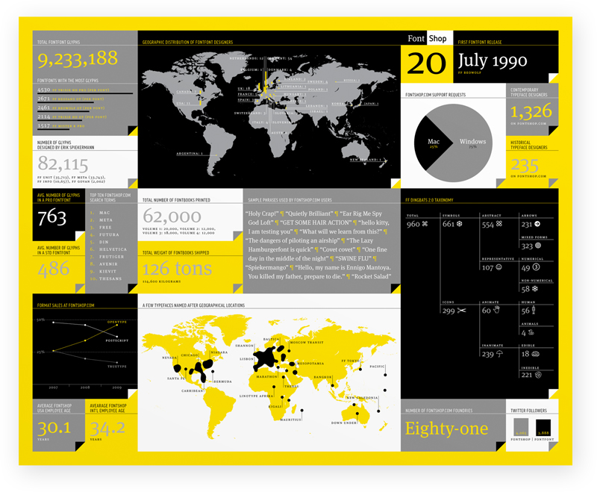

Slide 62
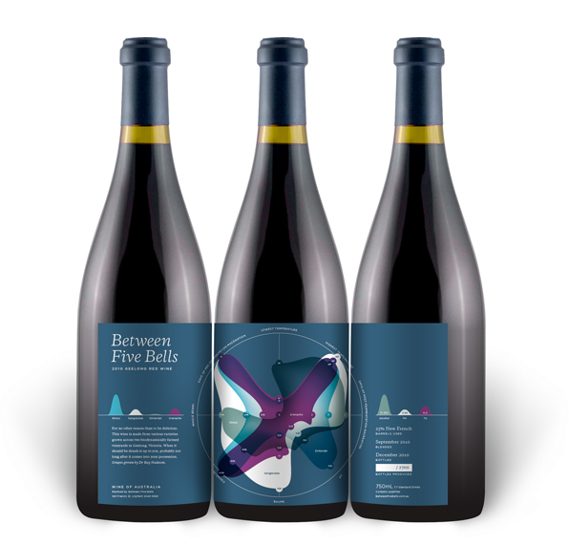

Slide 63
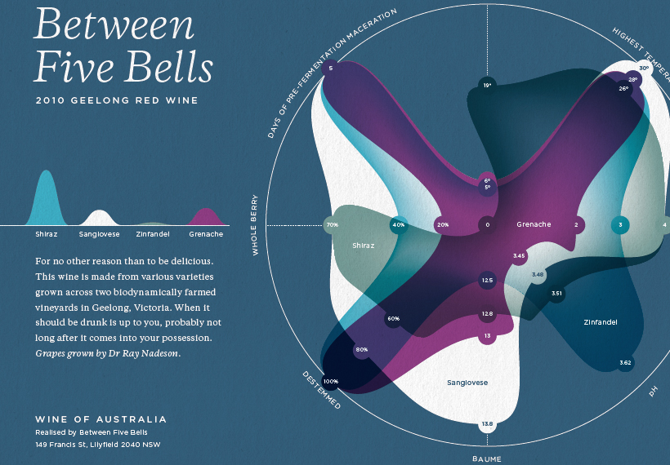

Slide 64
Daytum
Conceived by Nicholas Felton
Intended to be an elegant and intuitive tool for collecting and communicating personal data

Slide 66
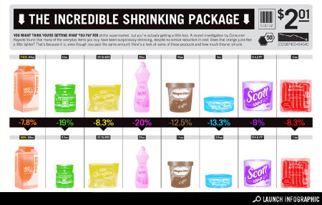
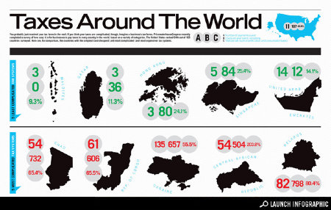
GOOD
“GOOD is the magazine for people who want to live well and do good.”
Unique visual aesthetic and focus on beautiful, informative, infographics.

Slide 67
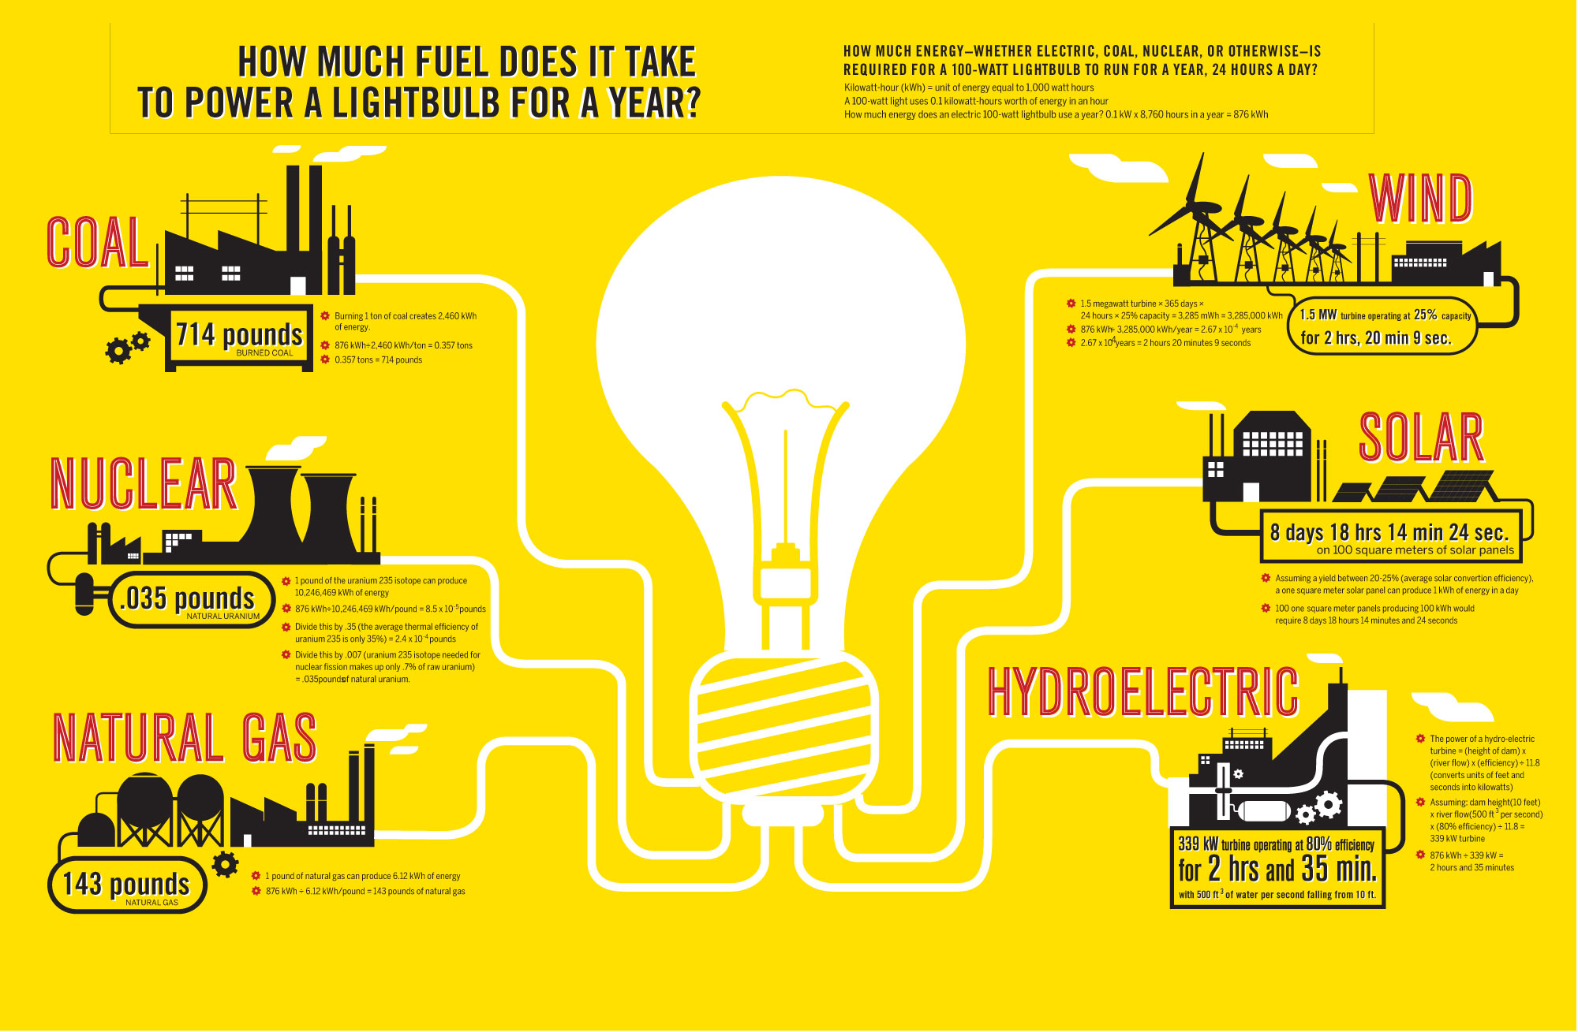
How much fuel does it take to power a lightbulb for a year? No clear winner, but some pretty shocking numbers

Slide 68
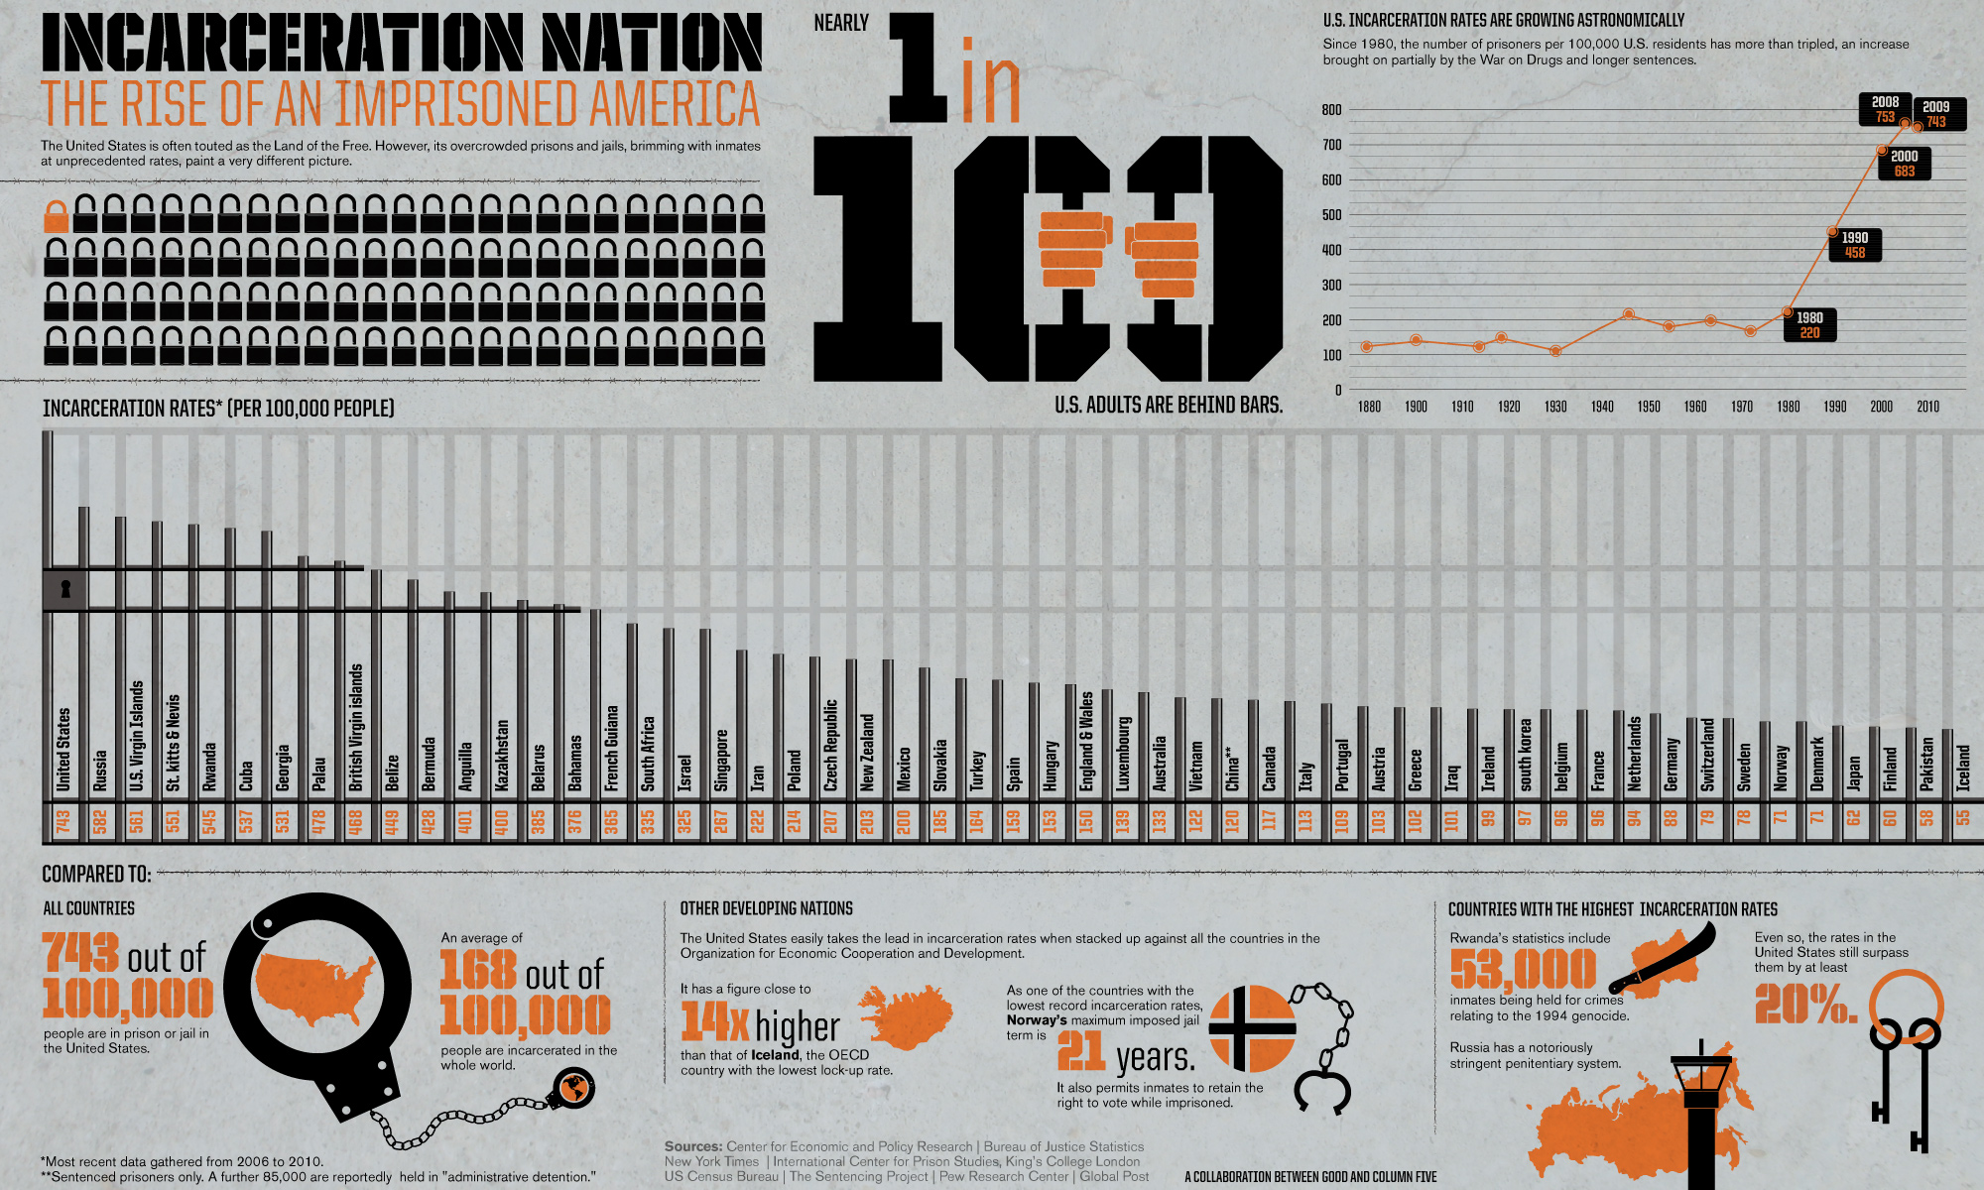
How does the USA stack up against other countries when it comes to incarceration?

Slide 69
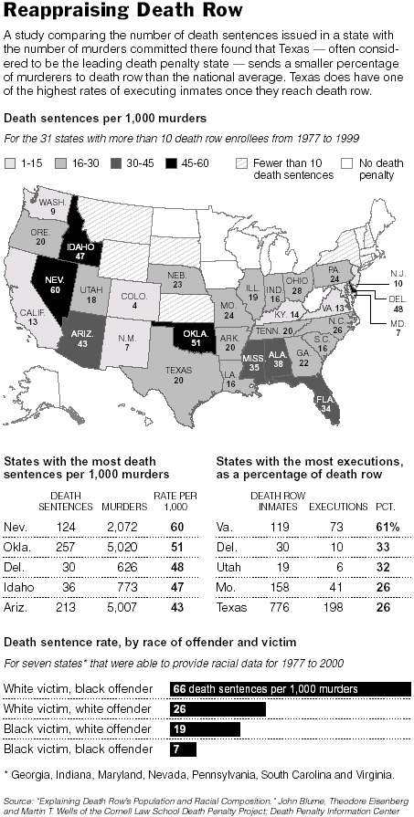
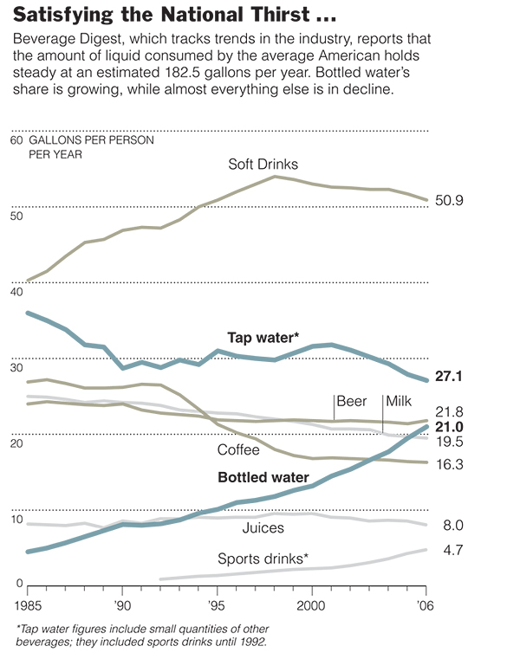
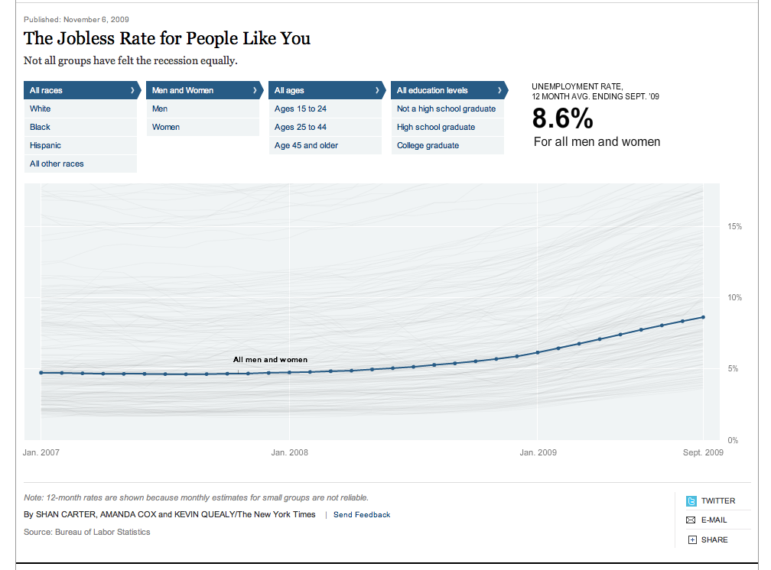
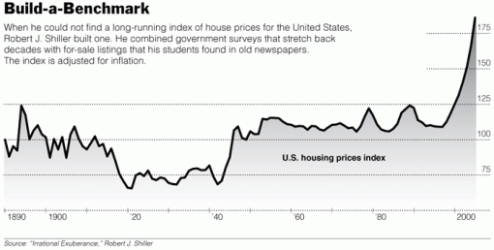
New York Times
Aggressively using data visualization across both print and interactive
Very strong consistent look and feel
Strong editorial support

Slide 70
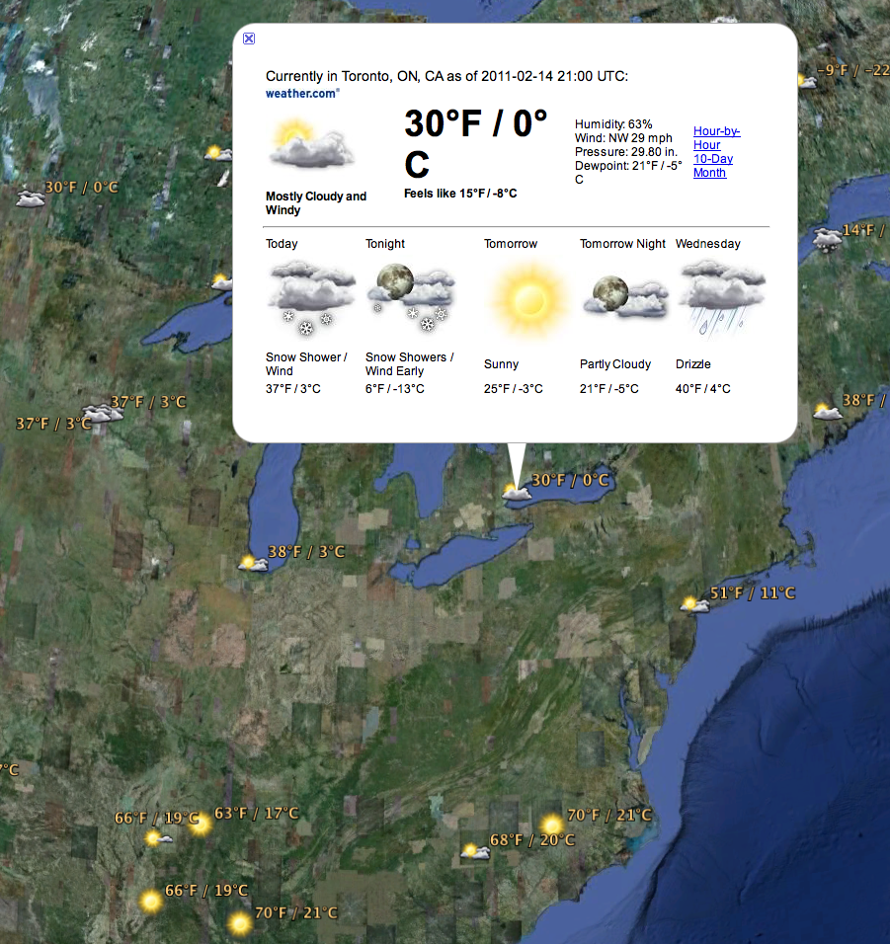

Google
Starting to get very aggressively into data visualization
Everywhere, from weather and local user data in Google Earth to financial news in finance.google.com

Slide 71
Google Books word usage viewer comparing thy and your
http://ngrams.googlelabs.com/graph?content=thy,your&year_start=1500&year_end=2008&corpus=0&smoothing=1

Slide 72
What I wish
I’d known in 2004

Slide 73
vis.stanford.edu/
http://vimeo.com/channels/stanfordvis#14777910

Slide 74
Many Eyes
The thinking person’s daytum
Web interface for developing and sharing visualizations of any dataset
Fantastic, simple tutorials
Takes care of the details
Great introduction to visualization
http://www-958.ibm.com/software/data/cognos/manyeyes/

Slide 75
Colour
Colour is used in a completely different way in data visualization
Colour palettes must be chosen based on the nature of the dataset being visualized
Sequential
  Suited for ordered data that progress from low values to high
    Eg population density
Diverging
  Suited for ordered data that has important mid range values and extremes at both ends of the set
    Eg temperature
Qualitative
  Suited for data where the magnitude of difference between values is not important
    Eg distribution of first names in an area

Slide 76
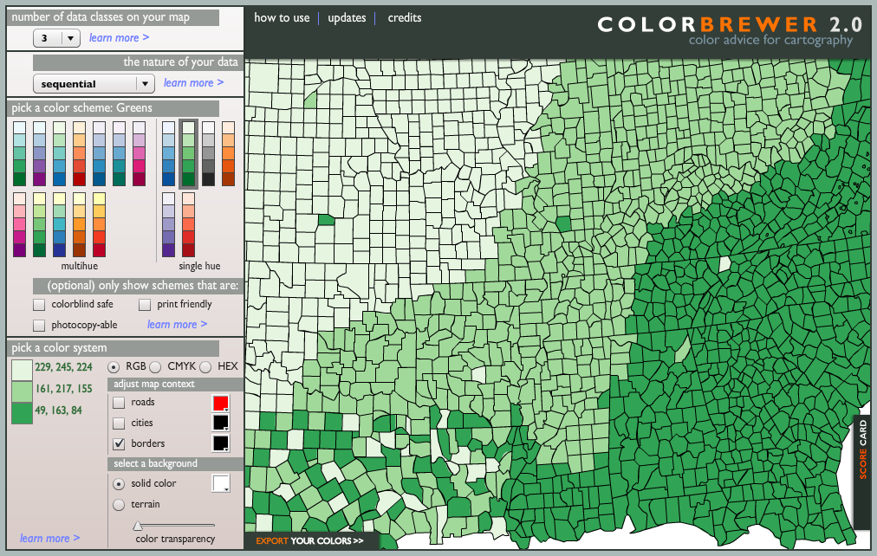
Colorbrewer2.org

Slide 77
Vischeck.com

Slide 78
Thank you

